Slide 1
Anatomy of Ovaries, Vagina
BY: M. G. HAMMAD

Slide 2
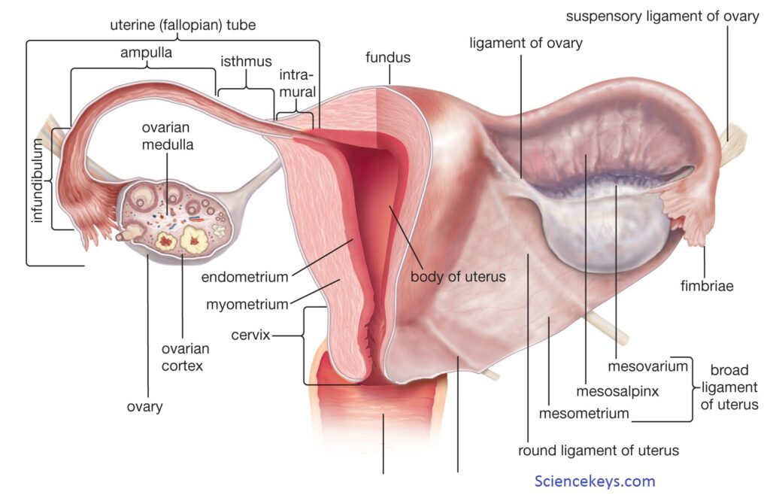
Anatomy of OVARY
The ovary is ovoid in shape, smaller than the testis.
Composed of dense ﬁbrous tissue in which the ova are embedded.
Projects into the pelvic cavity.
Attached to the posterior leaf of the broad ligament by a double fold of peritoneum {mesovarium}.

Slide 3
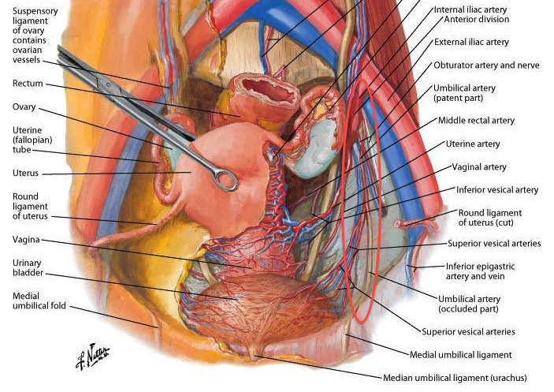
Anatomy of OVARY
Location:
The ovary lies on the peritoneum of the side wall of the pelvis.
In the shallow ovarian fossa.
Ovarian Fossa:
At the angle between the internal and external iliac vessels.
Here, it lies on the obturator nerve.
A diseased ovary may cause pain along the cutaneous distribution of this nerve.
Parietal peritoneum against which the ovary lies is supplied by O N.

Slide 4
Anatomy of OVARY
Location & Support:
In its normal position; can palpated by vaginal examination.
It is overlaid by the coils of sigmoid colon and ileum that occupy the pouch of Douglas.
It supported by:
Mesovarium.
Ovarian ligament:
Remains of the upper part of the gubernaculum.
Connects the lateral margin of the uterus to the ovary.
Suspensory ligament:
Part of the broad ligament.
Extending between the attachment of the mesovarium and the lateral wall of the pelvis.

Slide 5
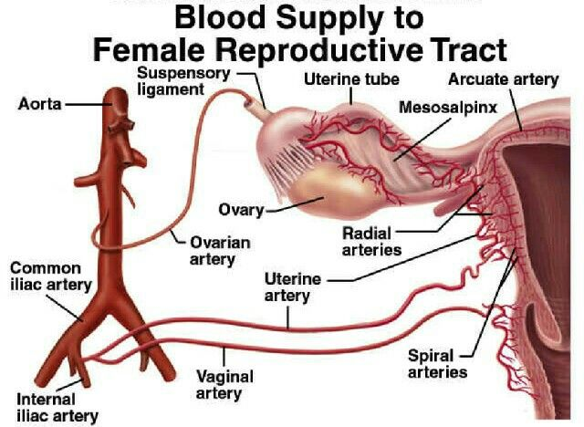
Blood supply of Ovary Arteries
The ovary is supplied by the ovarian artery.
A branch of abdominal aorta just below the renal artery.
The artery crosses ureter obliquely on psoas muscle.
It crosses pelvic brim and enters the suspensory ligament.
It gives off a branch to the uterine tube.
It ends by entering the ovary.

Slide 6
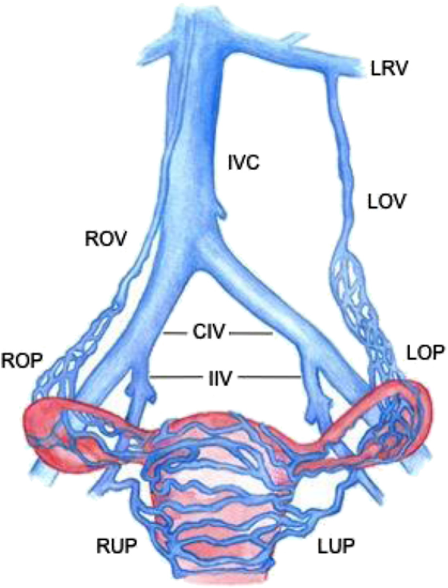
Blood supply of Ovary Veins
Small ovarian veins form a plexus in the mesovarium and the suspensory ligament.
The plexus drains into a pair of ovarian veins which accompany the ovarian artery.
That on the right joins the inferior vena cava, that on the left the left renal vein.

Slide 7
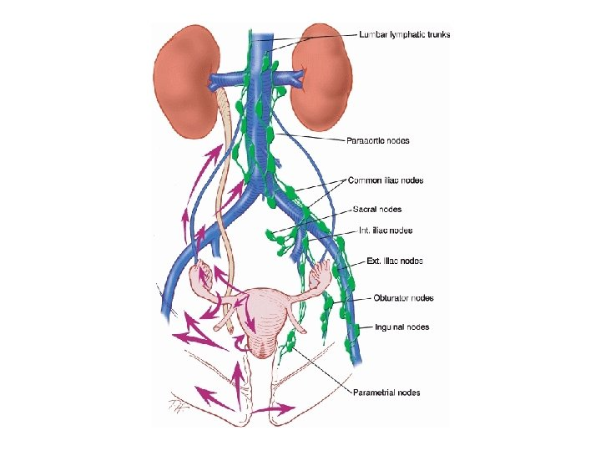
Lymph drainage
The lymphatics of the ovary drain to para-aortic nodes.
Alongside the origin of the ovarian artery.
Just above the level of the umbilicus (L2).

Slide 8
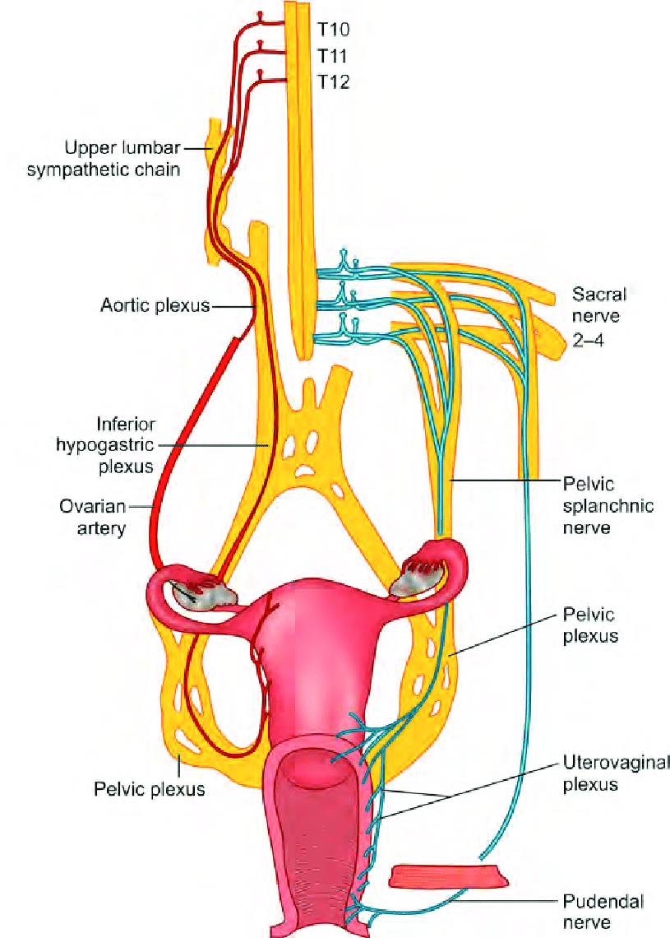
Nerve Supply
By autonomic N S.
Sympathetic:
It is vasoconstrictor & pain transmitter.
Preganglionic cell bodies at level of T10, T11 segments.
Reaches ovary from the aortic plexus along its blood vessels.
Parasympathetic:
Vasodilator.
From the inferior hypogastric plexus via the uterine artery.

Slide 9
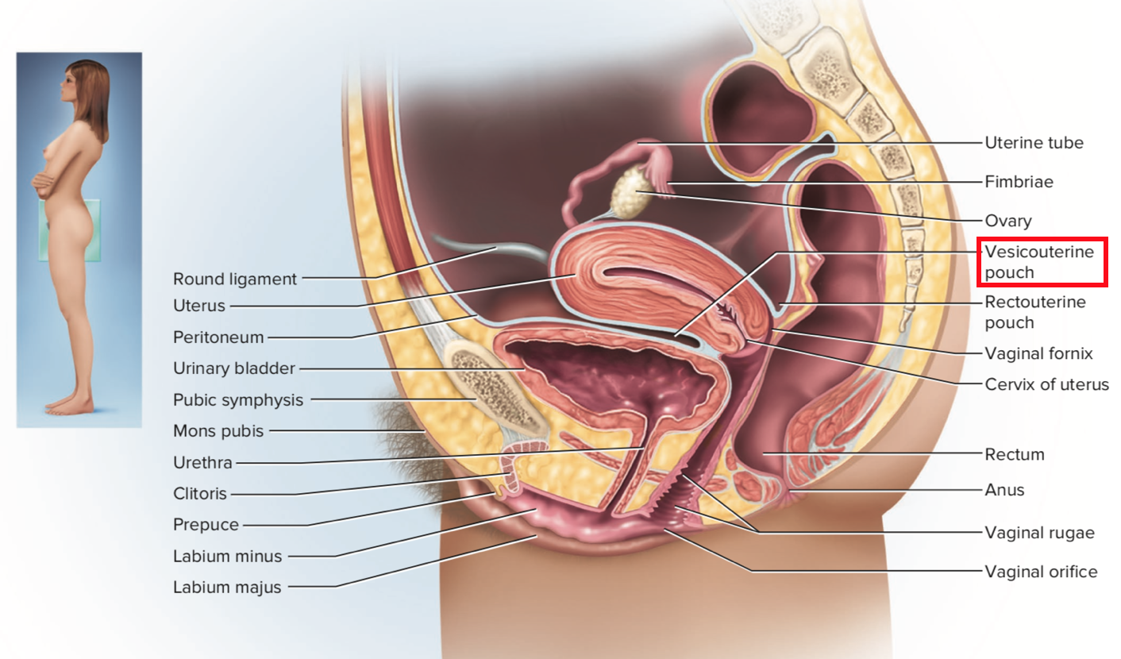
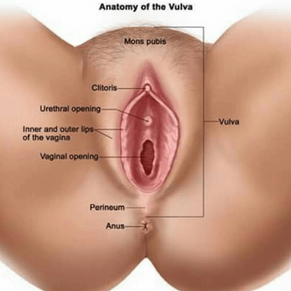
Anatomy of Vagina
A muscular tube.
Measures about 10 cm length.
Its cavity is transverse slit.
Its external orifice is anteroposterior slit.
Has anterior, posterior walls.
It extends from the uterine cervix to the labia minora.
Its lower end at perinium.

Slide 10
Anatomy of Vagina
Location:
It lies in front of:
Rectum.
Anal canal.
Perineal body.
Behind to:
Bladder.
Urethra.

Slide 11
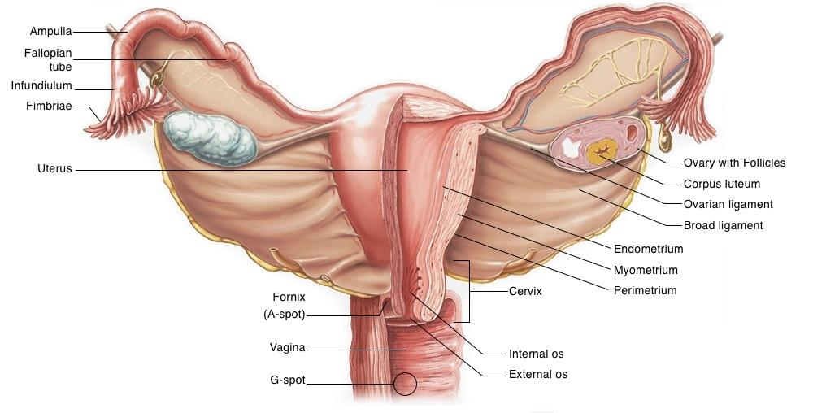
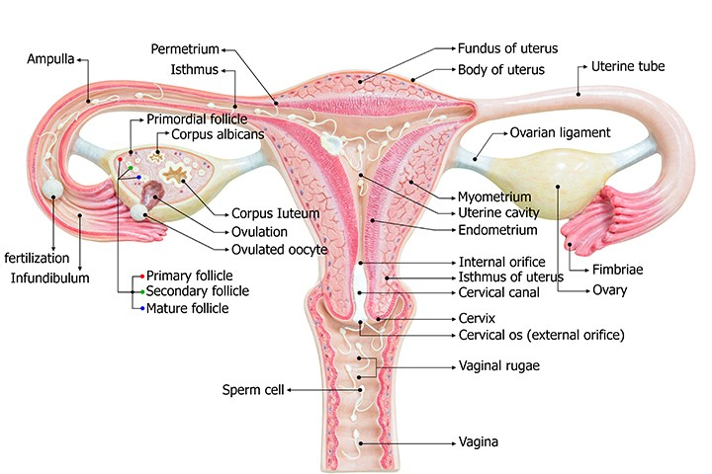
Anatomy of Vagina
Description:
The upper end expanded.
Receiving the uterine cervix which projects into it.
Forming around the margin of the cervix a circular groove {vaginal fornix}.
Vaginal fornix: divided into 3 parts:
Anterior fornix.
Posterior fornix.
Lateral fornix.

Slide 12
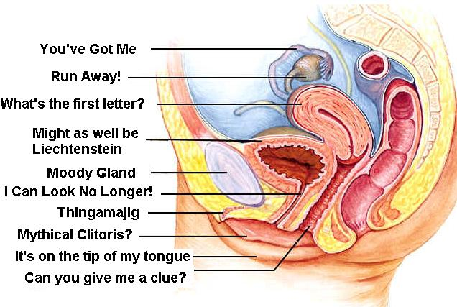
Anatomy of Vagina
Peritoneal covering & relation:
The only part of vagina which has peritoneal covering is posterior fornix.
The ureter ﬁrstly lies on lateral fornix.
Then passes over the front of the anterior fornix to enter the bladder.
Below the cervix the anterior wall of the vagina is in contact with the base (posterior surface) of bladder & urethra.

Slide 13
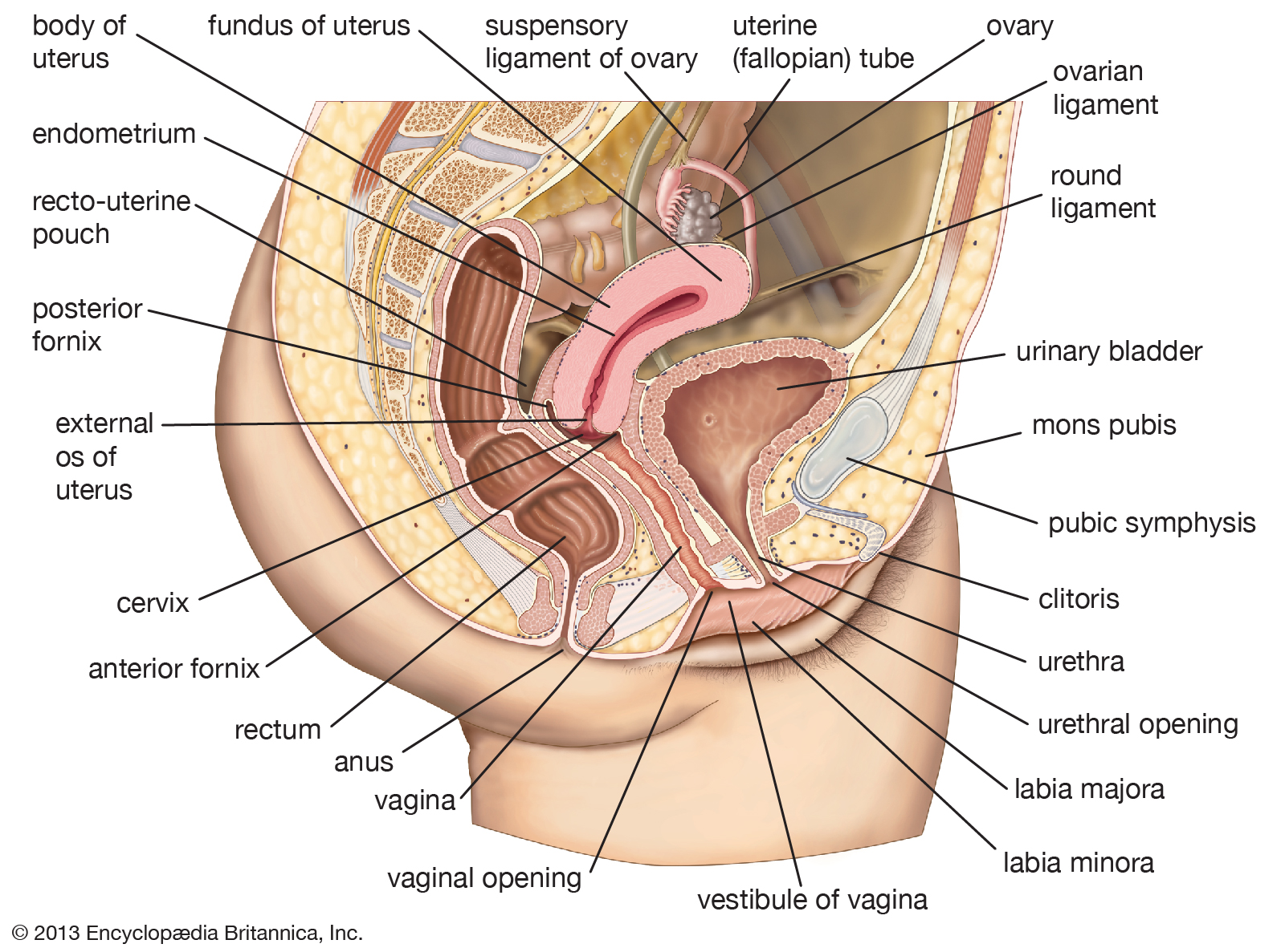
Anatomy of Vagina
Peritoneal covering & relation:
The vagina passes down between the pubovaginalis parts of levator ani,
Through the urogenital diaphragm and perineal membrane to become the vestibule of the vagina.

Slide 14
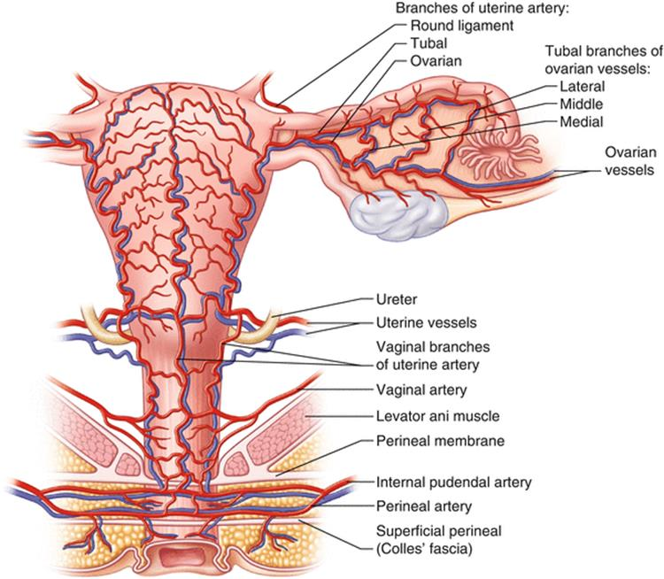
Blood supply of Vagina Arteries
Mainly by vaginal branch of the internal iliac artery.
Other sources include:
Uterine artery.
Inferior vesical artery.
Middle rectal artery.

Slide 15
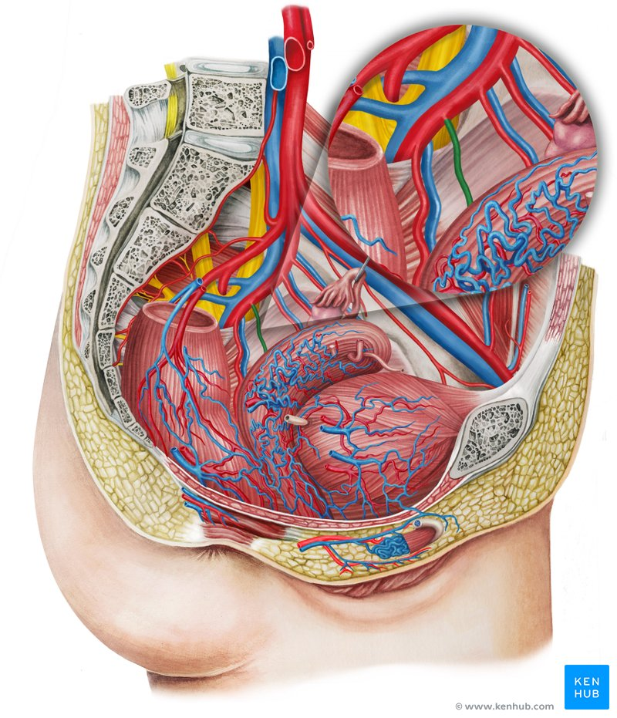
Blood supply of Vagina Veins
Veins join the plexuses on the pelvic ﬂoor to drain into the internal iliac vein.

Slide 16
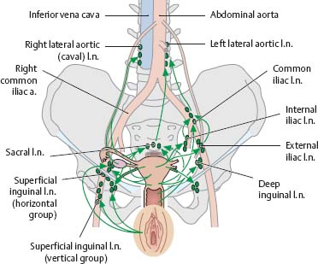
Lymph drainage
Above level of hymen:
Drains to external and internal iliac and sacral nodes.
Below level of hymen:
Drains to superﬁcial inguinal nodes.

Slide 17
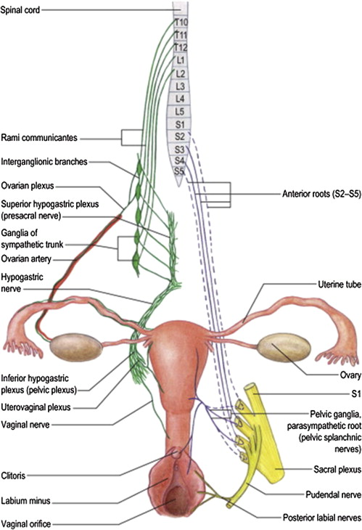
Nerve Supply
Lower end:
Receives sensory fibers from:
Perineal & posterior labial branches of pudendal nerve.
Ilioinguinal nerve.
Upper part:
Insensitive to pain.
Respond to stretch.
It receives sympathetic fibers from the hypogastric plexuses for supplying blood vessels and the smooth muscles of wall.

Slide 18
That is all…

